Slide 1

Designing a Scalable and Secure Mobile Payment System Using Blockchain Technology
NAME: AVES KHAN
CLASS: BCA III
ROLL NO: 8

Slide 2
Introduction to the Project
The Cryptocurrency Payment System is a web application for secure crypto transactions. The global crypto payment gateway market is projected to reach $5.4 billion by 2031. This system offers user authentication, wallet management, and transaction processing. It operates without central authority, leveraging blockchain for security and transparency.
The system enables users to create accounts and manage multiple cryptocurrencies. Users can send and receive funds and maintain a transparent transaction history. The system addresses the growing need for efficient cryptocurrency management.

Slide 3
Algorithm Evaluation Process
The system employs SHA-256 hashing for password security. A specialized algorithm generates unique wallet addresses. Transaction validation algorithms verify funds and confirm recipients. JSON-based storage maintains user data and transaction records. The interface guides users through processes with minimal friction.
The development involved rigorous algorithm evaluation. Each algorithm was evaluated based on security, performance, and user experience. This ensures the system meets industry standards.

Slide 4

Objectives and Need of the Project
The primary objectives include providing a secure environment for crypto transactions. The system aims to implement a user-friendly interface and support multiple cryptocurrencies. It enables real-time transaction processing and maintains a transparent record. The system ensures scalability and robust authentication.
The growing adoption of cryptocurrencies has created demand for user-friendly interfaces. Traditional systems have high fees and long processing times. The crypto payment gateway market is projected to grow significantly. The system addresses the need for improved security and simplified user experiences.

Slide 5

FEASIBILITY STUDY
Analyzing the project’s viability ensures alignment with goals.
Feasibility covers technical, economic, and operational aspects.
1
Technical Feasibility
2
Operational Feasibility
Verifies resources and tech skills for project completion.
Confirms alignment with business operations and workflows.
3
Legal Feasibility
Ensures project complies with all legal requirements.

Slide 6
System Design
The system employs a JSON-based database design for simplicity and portability.
The database consists of three primary JSON files: users.json, wallets.json, and transactions.json.
The username serves as the primary key in users.json and a foreign key in wallets.json.
Transaction records maintain referential integrity through username references.
This design prioritizes simplicity while maintaining data integrity. It is suitable for prototype development and small-scale deployments.

Slide 7
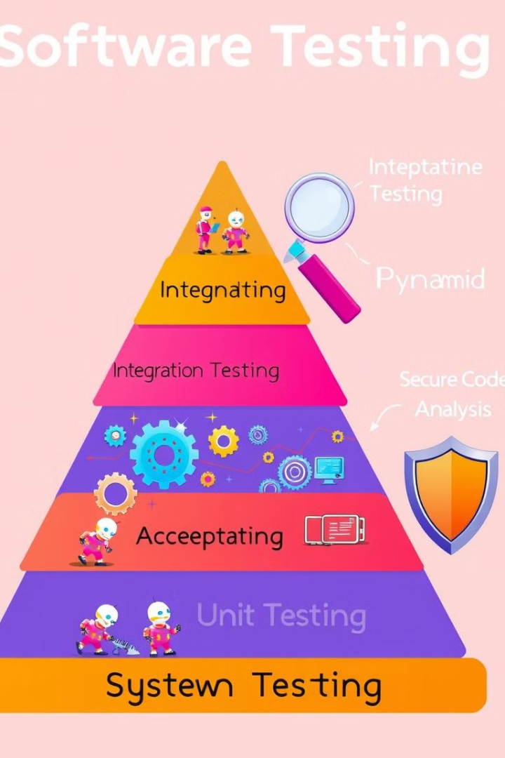
Testing Techniques
Comprehensive testing is critical for the Cryptocurrency Payment System. Testing must verify authentication mechanisms and prevent unauthorized access. Cryptocurrency transactions are irreversible. Testing ensures transaction validation logic is correct. A structured testing approach is essential.
The system employs a multi-layered testing strategy. Unit testing verifies individual functions. Integration testing verifies the interaction between components. Functional testing verifies that the system meets its requirements. Security testing prevents vulnerabilities.

Slide 8
Hardware and Software Requirements
Hardware Requirements
Software Requirements
Minimum Processor: Intel Core i5 or equivalent RAM: 8GB minimum, 16GB recommended Storage: 256GB SSD Network: Stable internet connection
Operating System: Windows 10, macOS Mojave, or Linux (Ubuntu 18.04) Programming Languages: Python 3.7+, JavaScript (Node.js) Database: JSON Web Framework: Express.js

Slide 9
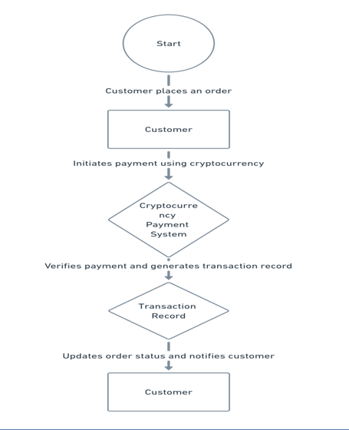
DFD :

Slide 10
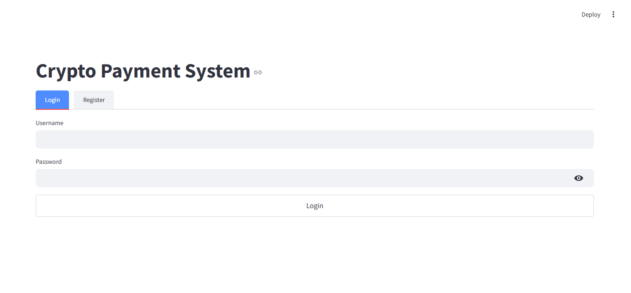
OUTPUT :

Slide 11
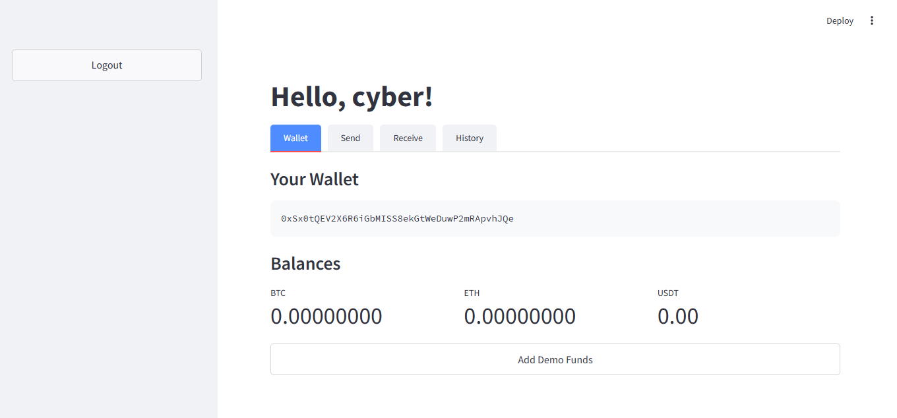

Slide 12
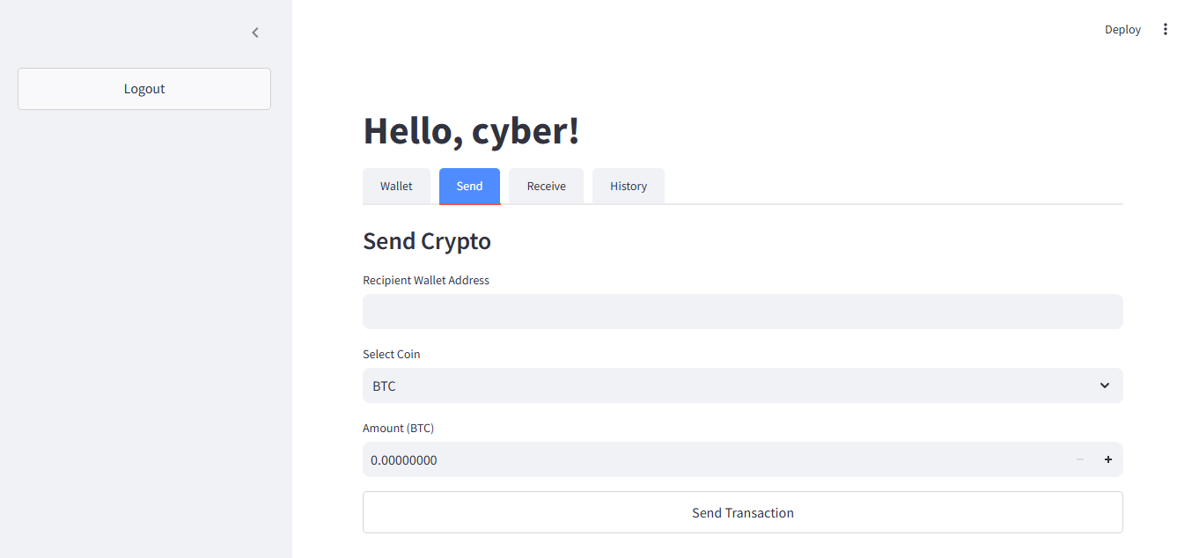

Slide 13
Conclusion and Future Scope
The Cryptocurrency Payment System presents a comprehensive approach to cryptocurrency management. The system demonstrates core principles of blockchain-based financial applications. The system aligns with market trends showing growth in crypto payment gateway adoption.
Future enhancements include blockchain network integration and database upgrades. Security enhancements could include multi-factor authentication. The system could expand to support additional cryptocurrencies. These enhancements represent a roadmap for evolving the system.

Slide 14
Thank You
We appreciate your time and attention. We are available for questions.
NAME : AVES KHAN
CLASS : BCA III
EMAIL : AVESKHAN900@GMAIL.COM

